Slide 1

Enhancing Search Engine Relevance for Video Subtitles
By:
Team ID-
1.Singireddy Pravalika-IN1241193
2.Pothureddy Naga Triveni–IN1241106

Slide 2


OBJECTIVE OF THE PROJECT
Develop an advanced search engine algorithm that efficiently retrieves subtitles based on user queries, with a specific emphasis on subtitle content.
The primary goal is to leverage natural language processing and machine learning techniques to enhance the relevance and accuracy of search results.

Slide 3
TYPES OF SEARCH ENGINE
Keyword Based Search Engine: These search engines rely heavily on exact keyword matches between the user query and the indexed documents.
Semantic Search Engines: Semantic search engines go beyond simple keyword matching to understand the meaning and context of user queries and documents.

Slide 4
PROCESS INVOLVED
Part 1: Ingesting Documents
Data Decoding
Data Sampling
Data Preprocessing
Document Chunker
Text Vectorization
Storing Embeddings
Part 2: Retrieving Documents

Slide 5
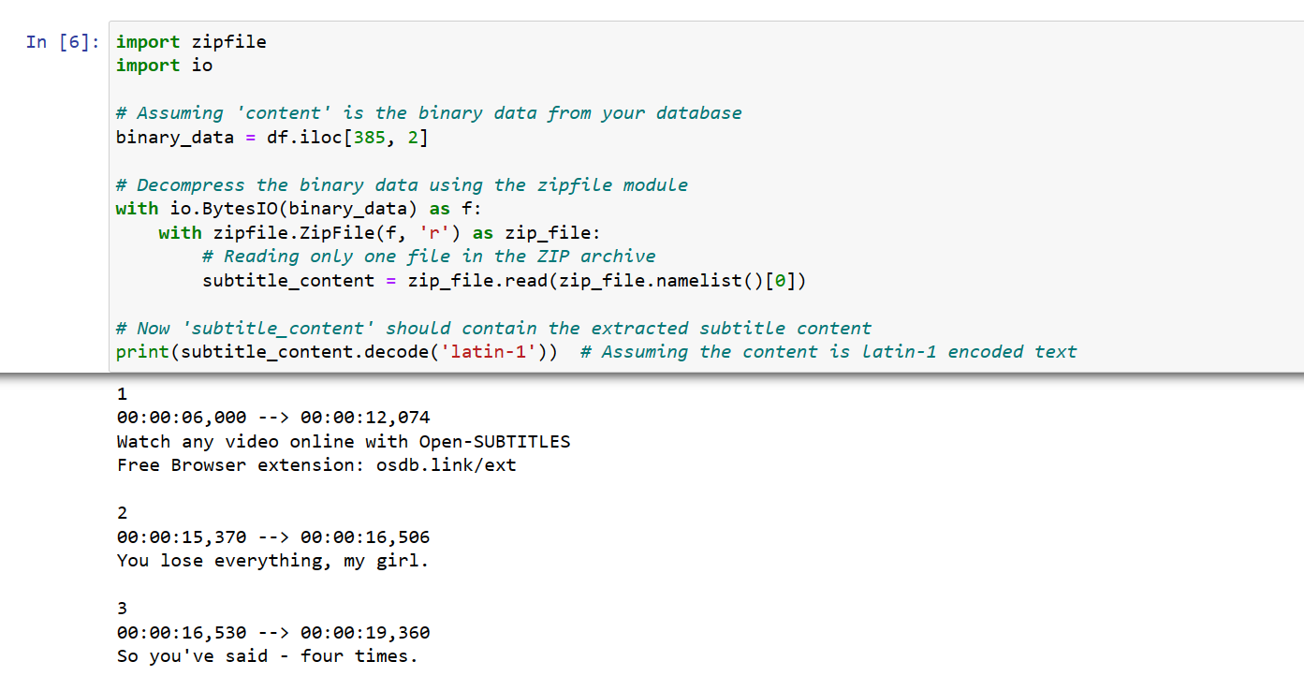
Part 1: INGESTING DOCUMENTS
Data Decoding :
The subtitle content are encoded and they are decoded in Latin-1 and stored in data frame.

Slide 6
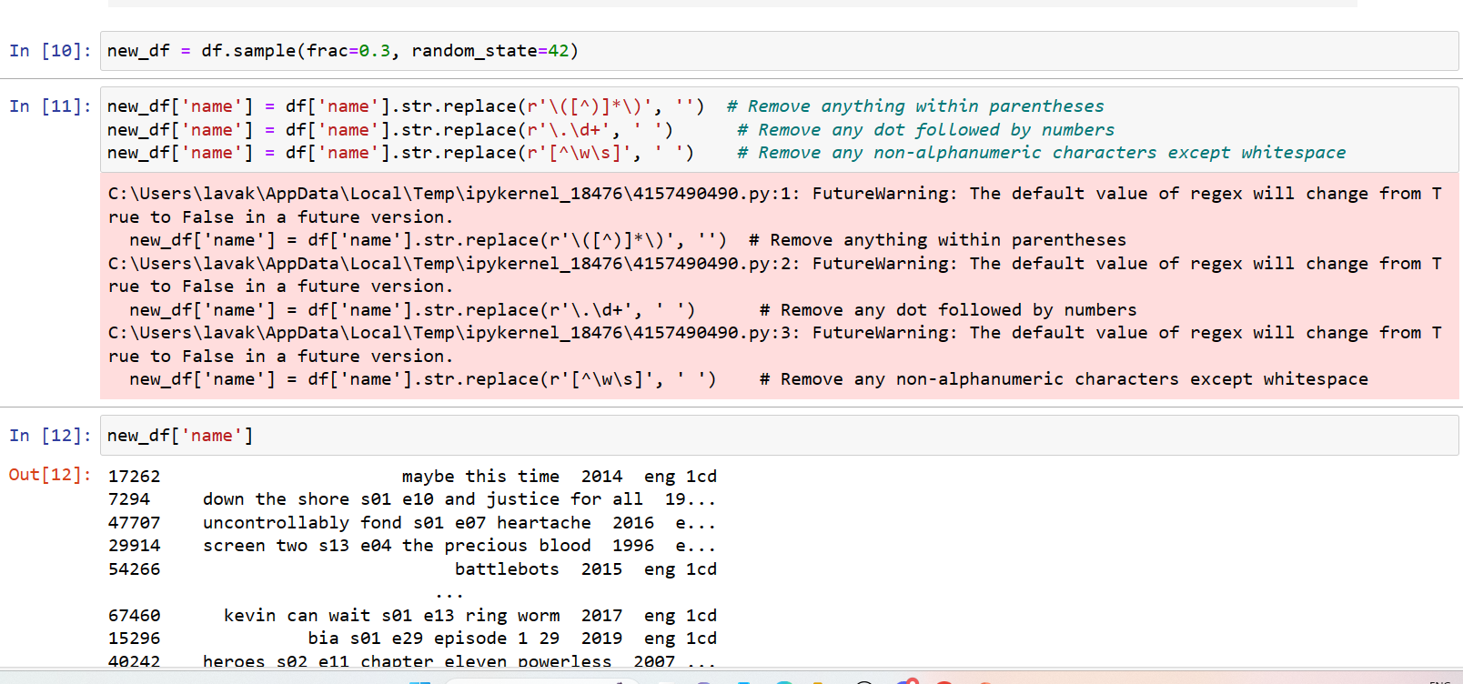
Part 1: INGESTING DOCUMENTS
Data Preprocessing:
The data preprocessing step includes removing unwanted content,
symbols , spaces , timestamps.
Converting the text to lowercase.

Slide 7
Part 1: INGESTING DOCUMENTS
Document Chunker :
It is often not practical to embed an entire document as a single vector, particularly when dealing with long documents.
Divide a large document into smaller, more manageable chunks for embedding.
Let’s say we set the token window to be 500, then we’d expect each chunk to be just below 500 tokens. One common concern of this method is that we might accidentally cut off some important text between chunks, splitting up the context. To mitigate this, we can set overlapping windows with a specified amount of tokens to overlap so we have tokens shared between chunks.

Slide 8
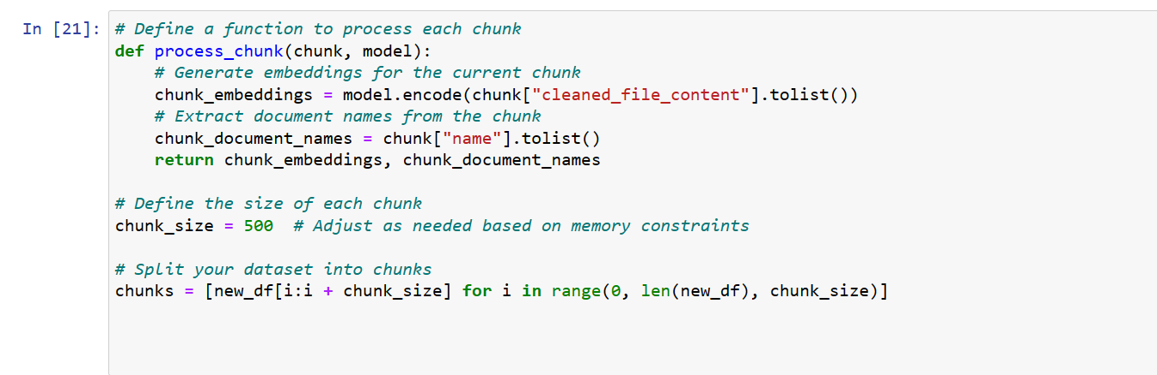
Part 1: INGESTING DOCUMENTS
Document Chunker

Slide 9

Part 1: INGESTING DOCUMENTS
Text Vectorization:
To generate text vectors of subtitle documents:
BOW / TFIDF to generate sparse vector representations. Note that this will only help you to build a Keyword Based Search Engine.
BERT based “ Sentence Transformer('all-MiniLM-L6-v2')” to generate embeddings which encode semantic information. This can help us build a Semantic Search Engine.

Slide 10
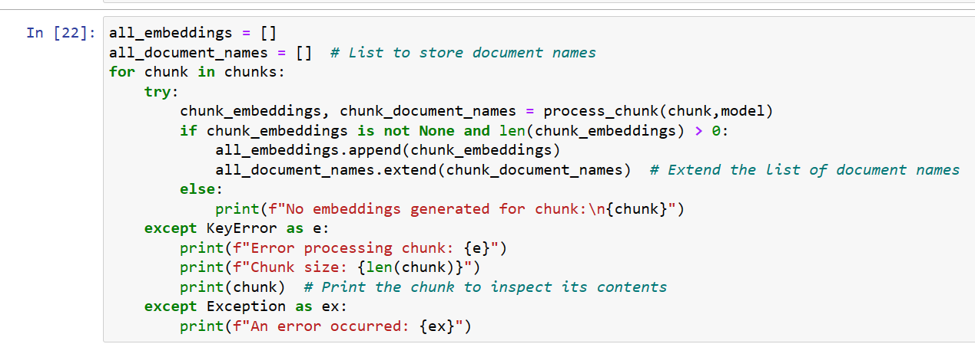
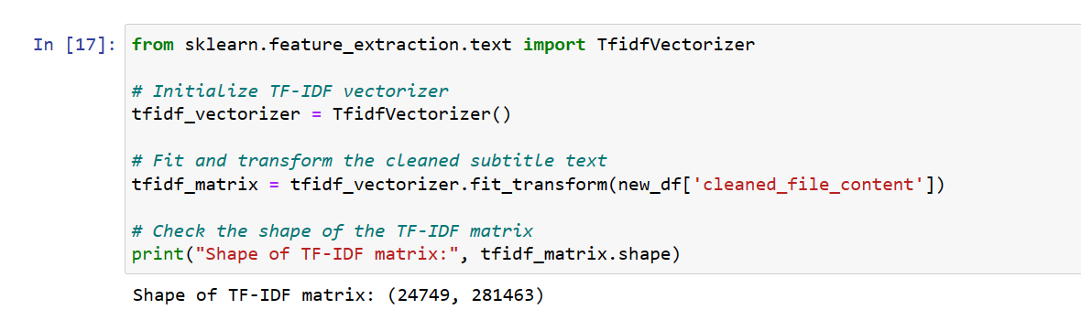
Part 1: INGESTING DOCUMENTS
Text Vectorization:

Slide 11
Part 1: INGESTING DOCUMENTS
Storing Embeddings in ChromaDB database:
ChromaDB is used for storing text embeddings because of its specialized features and capabilities that make it well-suited for managing and querying high-dimensional embeddings efficiently.
The process of creating and populating a collection in the ChromaDB database with embeddings generated using a Sentence Transformer model.

Slide 12
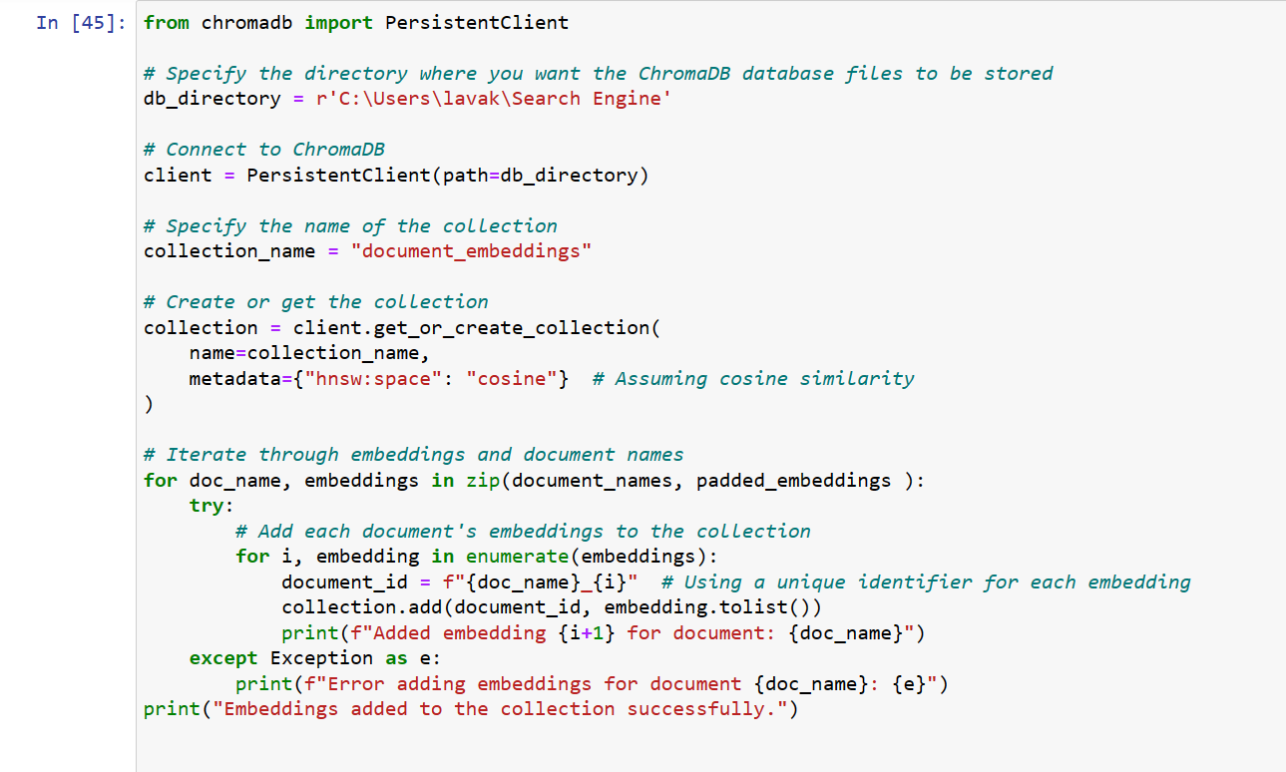
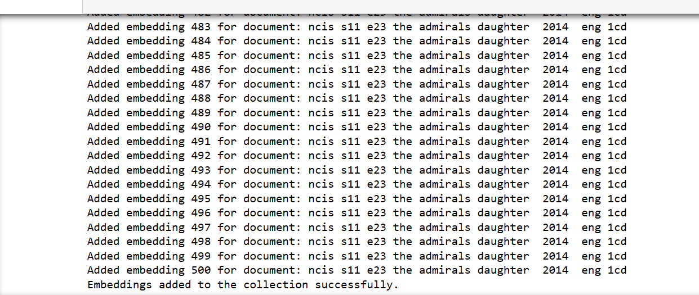
Part 1: INGESTING DOCUMENTS
Storing Embeddings in ChromaDB database:

Slide 13
Part 2: RETRIEVING DOCUMENTS
Take the search query as input from the user.
Preprocess the user query i.e., clean the user input by converting it to lowercase.
Convert the user's query into a numerical vector representation using the same method as the subtitle documents.
Compute the cosine similarity between the vector representations of the subtitle documents and the user query.
Based on cosine similarity scores, it will return the subtitle documents with the highest cosine similarity scores, indicating their relevance to the user's query.

Slide 14
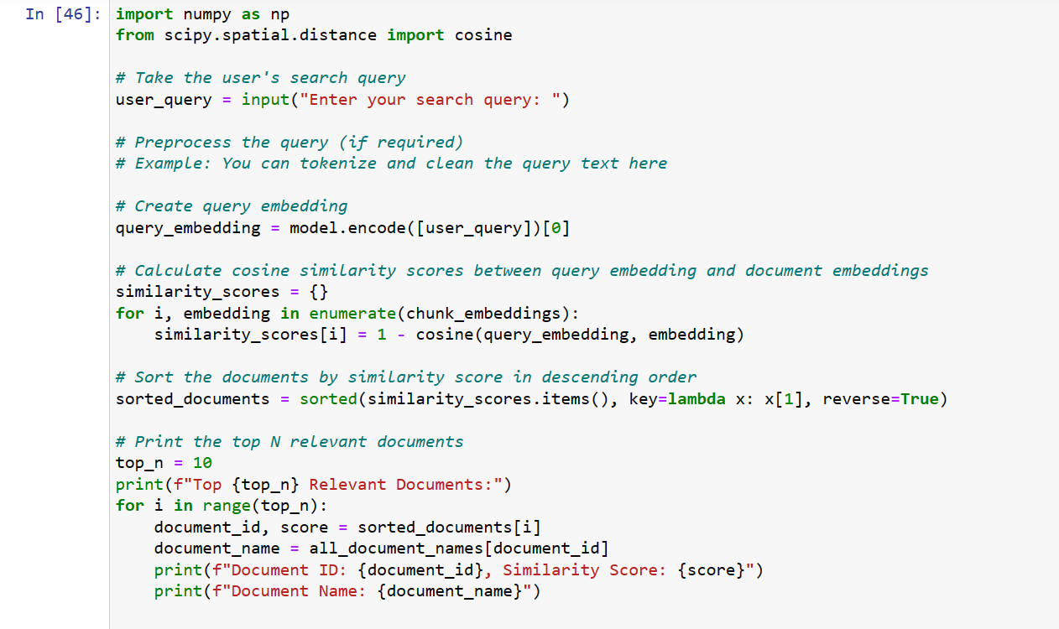
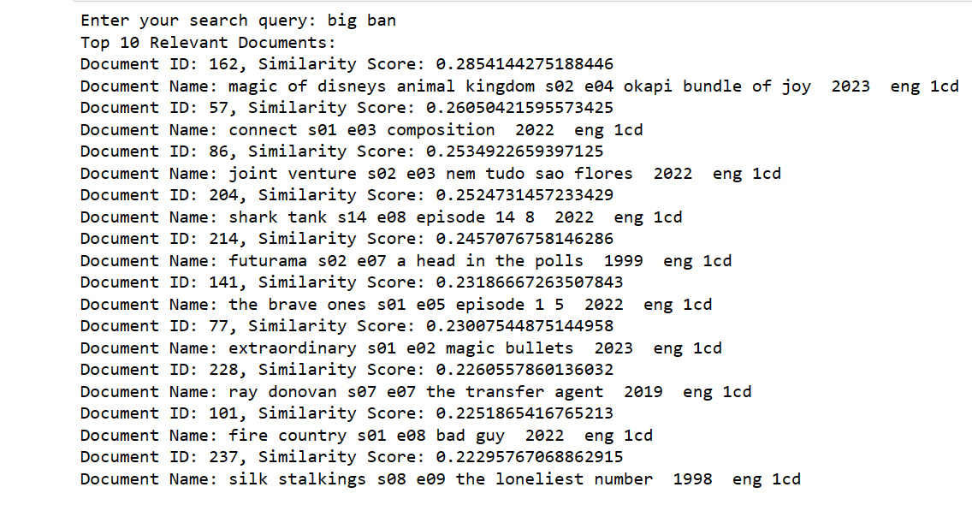
Part 2: RETRIEVING DOCUMENTS

Slide 15
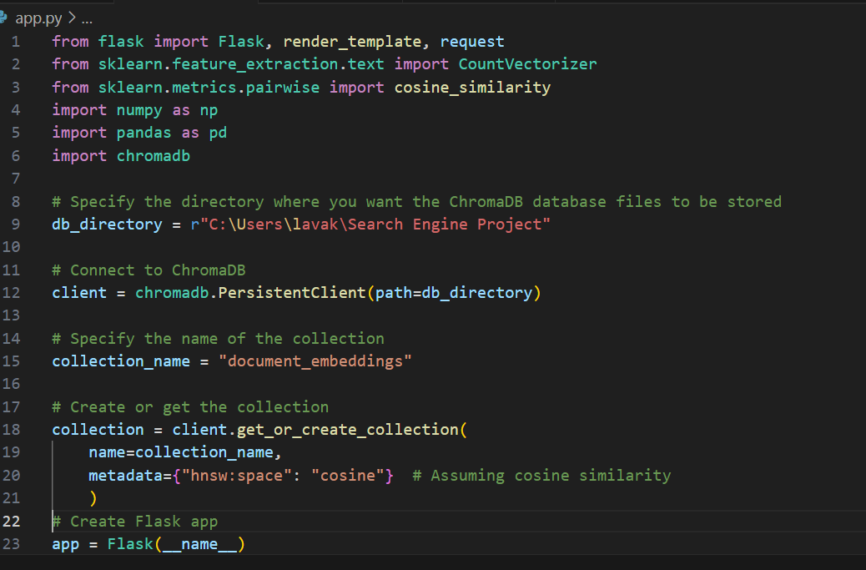
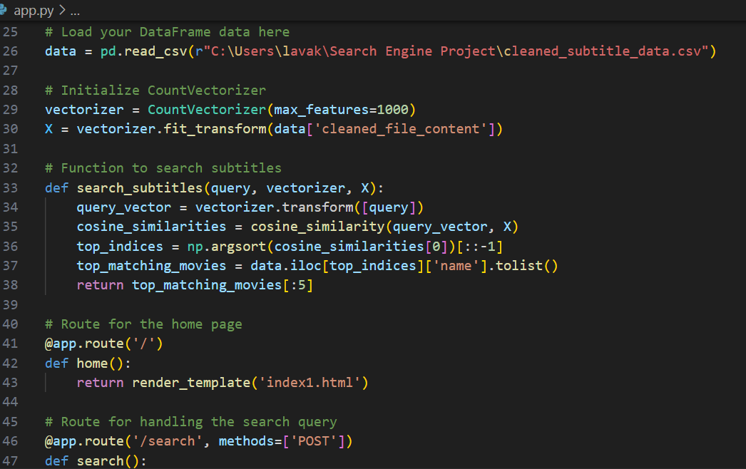
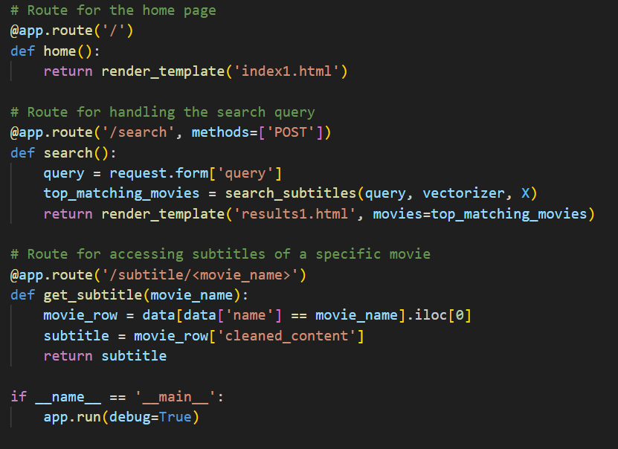
IMPLEMENTATION
FLASK CODE:

Slide 16
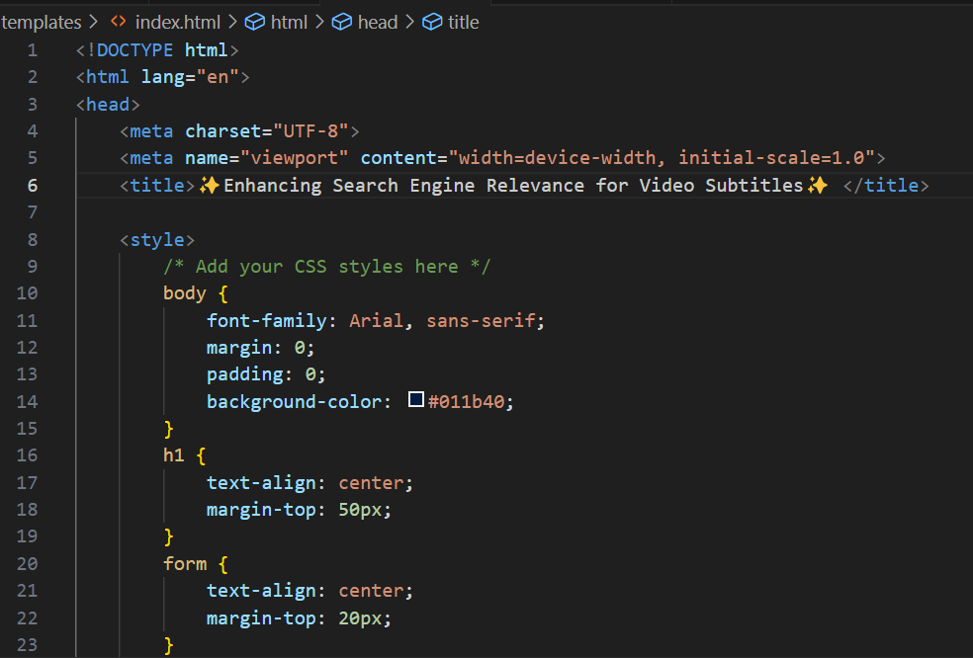
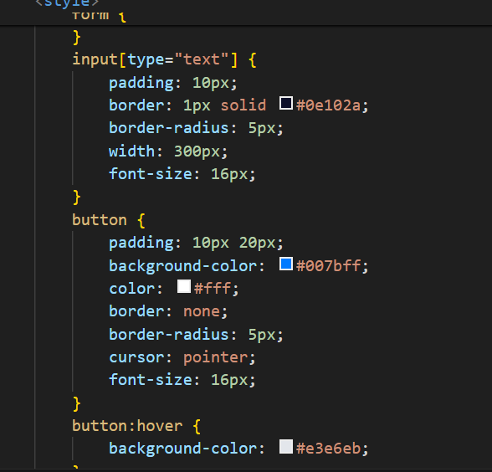
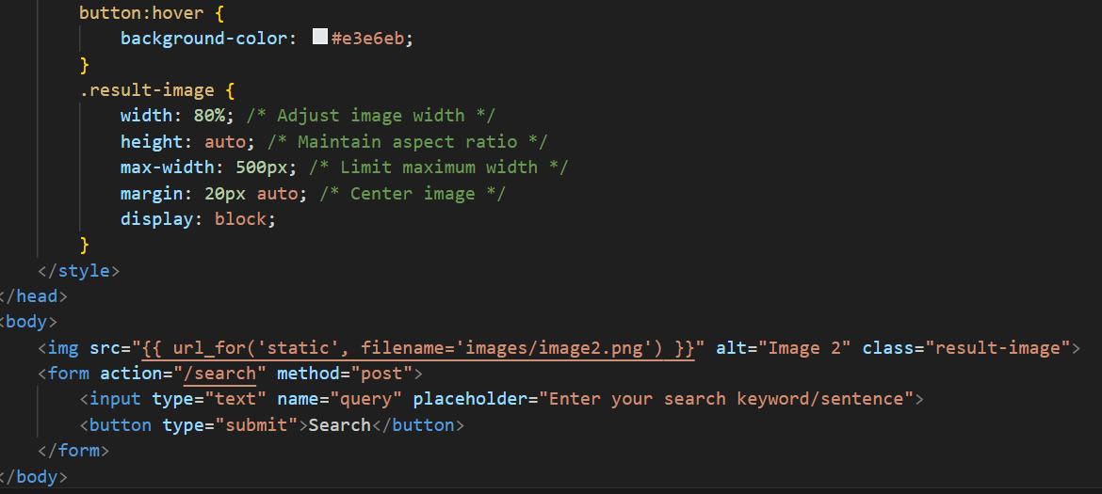
IMPLEMENTATION
INDEX.HTML:

Slide 17
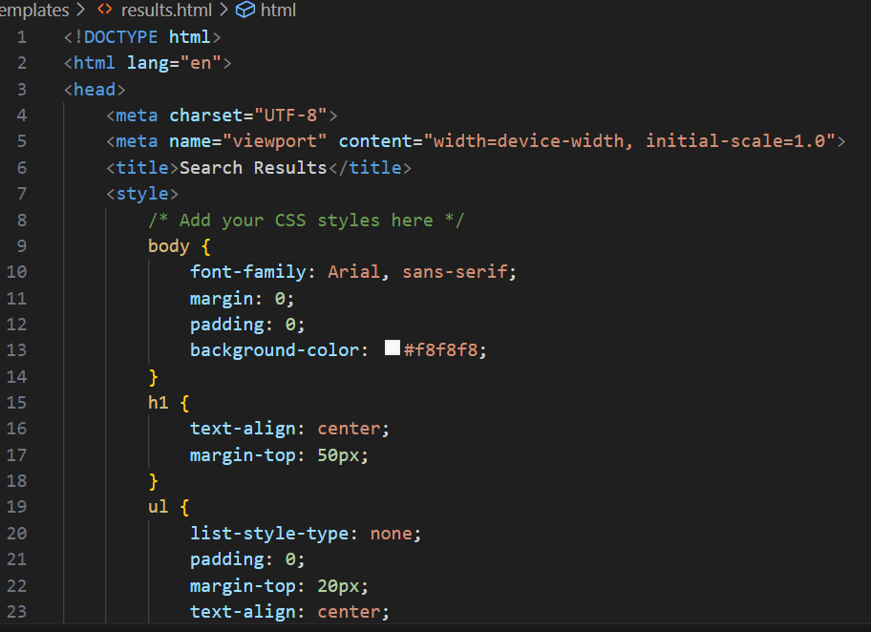
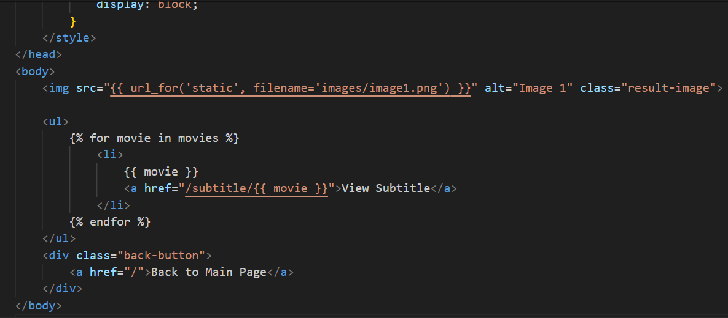
IMPLEMENTATION
RESULTS.HTML:

Slide 18

OUTPUT

Slide 19
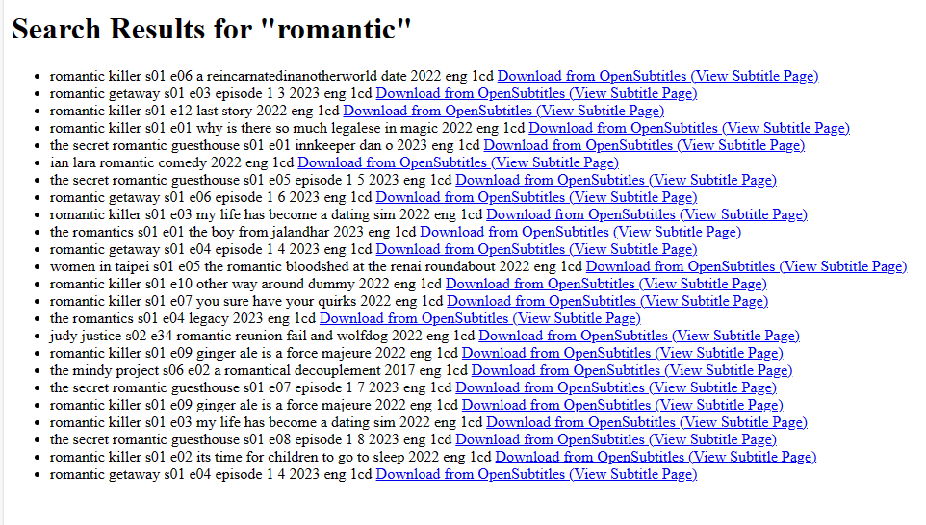
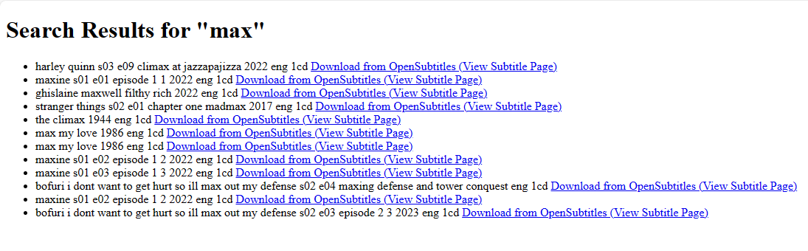
OUTPUT

Slide 20


THANK YOU

